Slide 1




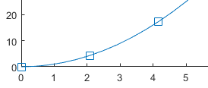

2017 UBS Group Technology and Operations Case Challenge
REVEALING THE PROMISED LAND
Synergy for Achieving Financial Excellence
Charles WONG | Ken CHEUNG | Michelle MA
[1] Multisource Reference Checking and Alert System
Price discrepancy risk is not mitigated if Elite Bank continues to lean on single data source for compiling daily profit and loss. To capture a more accurate market price, it is advisable to have at least one more market data source for comparison purpose. For instance, Bloomberg is a renowned financial data vendor with the provision of data terminal services. A cross-check between the market data from Reuters and Bloomberg is necessary to confirm the data accuracy, especially during the market-close period. Whenever there is a price discrepancy, the alert system will be triggered and corrective actions must be taken. Below are the two layers of the defense mechanism.
[1.1] EM Algorithm for Estimation of Missing Entries and Trends Expectation-Maximization (EM) algorithm is a general, iterative algorithm for parameter estimation by maximum likelihood when random variables involved in a time series are not served (i.e. missing stock prices in certain time stamps). Missing data points can be estimated through multiple layers of simulations, the trendline of a certain stock can therefore be regeneralized.
Simplified Data Log-Likelihood (Rubin 1976):
F(θ|Yobservation) = f1(θ|Y) – log[ f2(Ymissing|Yobservation ;θ) ]
Elite bank recognizes the quotes provided by exchanges should be the most reliable data. However, the deployment of EM algorithmic machine learning system can be utilized as preliminary parameters for alert trigger, in accordance with the mean squared errors of deviant data points.
Despite accessible information can be provided by exchanges directly, it is still essential to rely on Blomberg and Reuters for real-time market data feeding, especially for financial instruments traded outside the exchange.
[1.2] System Linkage with Exchange
In case the emergency alert is triggered due to the inconsistency of market data from Bloomberg and Reuters, the data from the exchange determines the closing price of the securities. For securities traded on the exchange, data from the exchange must be reliable. For example, the closing price of HSBC (HKG:0005) can be found on HKEx whereas the closing price of The Coca-Cola Co (NYSE: KO) can be identified on New York Stock Exchange. With a sharp focus on the equity desk, Elite Bank can purchase stock price data from HKEx and other exchanges directly. All essential stock information, such as high, low, closing price and turnover can be obtained in CSV format. Since a broad range of products such as options and futures are being traded by the equity desk on a daily basis, the marginal costs of price data subscription (e.g. from HKEx) are therefore reasonable expenses.
[2] Chatbot for In-House Support
P&L corrections were unable to be completed after office hours due to the lack of manpower in the Data Integrity Team. With the help of chatbots or conventional robotic advisors, instant feedback can be generated with preset computerized program designated to simulate an intelligent conversation with one or multiple human users, in natural language via auditory or textual methods. Preinstalled solution manual can be immediately delivered with 90% of relevance and is available 24/7. The application of chatbots is a time-saving and cost-efficient process, which eases the burden of system supporters.
Essentials in Trades
Price Discrepancy Error here refers to the inconsistency between the real market-close price and the price shown on Reuters Terminal.
 | (a) MarketBox Errors of External Data Sources
 | (b) MoneyClip Wrong Capturing of Spot Price
HKEx Subscription
($ in HKD)
Entry Level Package (Morning & market close) | 500
One Cross Connect | 1500
Daily Market Reports –Futures & Options | 600
Monthly Recurrent Fee ($) | 2600
EM Simulation
Suppose the red dot indicates a missing data point, whereas the blue squares are subsets of the time series plot. The value of red dot is computed by simulating the expected value through observing the whole dataset.
□ | □ | □ | • | □ | □ | □
Industrial News
 | Trading Speed for Jeopardy
The 2010 Flash Crash and the Knight Capital Incident in U.S. alerted the regulatory body to develop multiple solutions to curb market misbehavior.
Smarter Solutions Made Simple | Page 1

Slide 2
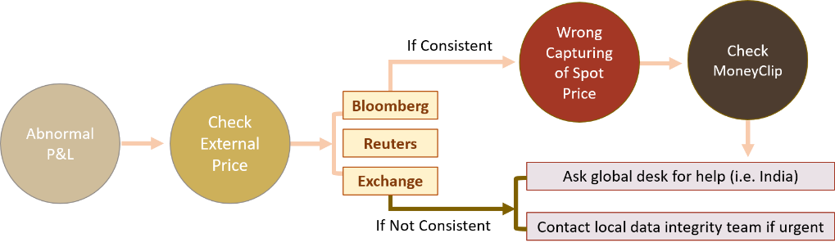
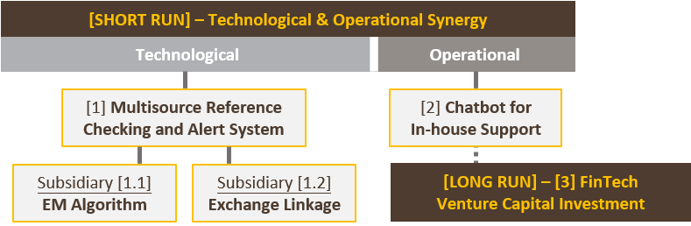
2017 UBS Group Technology and Operations Case Challenge
[SCENARIO ANALYSIS 2] Utilizing Chatbot for Operational Support
With the help of Chatbots or conventional robotic advisors, instant feedback can be generated with preset computerized program designated to simulate an intelligent conversation with one or multiple human users, in natural language via auditory or textual methods. [Prototype Link: http://3916a523.ngrok.io]
[SCENARIO ANALYSIS 1.1] EM Algorithm: Real Time Data Feeding
[SCENARIO ANALYSIS 1.2] Exchange Linkage: Market Closing
Implementation Risks
Project Risk Mitigation: identify the improved areas of proposed solution for better control of trade process, and indicate the marginal benefits
Compliance Risk Mitigation: Active backstage human control and periodic consultation with authorities and stakeholders
Data Integrity Risk Mitigation: Encryption, Multifactor authentications, uncorrupted transmission certification & backup
Real Time Data Feeding
Step 1 – Input Bloomberg data and Reuters data into the internal warehouse, let the automated system conduct the logical comparison. Step 2 – If the data matches, it passes “true” to EM system such that Bloomberg market data is adopted to compute the real-time P/L. Step 3 – If the data doesn’t match, it passes “false” to EM system, triggering the EM algorithmic function to approximate the “should-be” value. The figures generated by EM algorithm is then used to compute the real-time P/L for error estimation.
Bloomberg Database
Input
System
(Logical Comparison)
T/F Output
System
(P/L Compilation)
Reuters Database
True Input
Fill in the P/L sheet using Bloomberg Date or Reuters Data
System
(P/L Compilation)
Treatment
False Input
Fill in the P/L sheet using
the EM algorithmic computation
References:
KPMG Global Analysis of Investments in Fintech
J.P. Morgan Markets and Investor Services | eXecute
UBS KeyInvest – Products on Solactive FinTech TR Index
Market Closing
Step 1 – Input Bloomberg data and Reuters data into the internal warehouse, let the automated system conduct logical comparison. Step 2 – If the data matches, it passes “true” to the alert system such that Bloomberg market data is adopted to compute the P/L. Step 3 – Yet, if the data doesn’t match, capture the required data from the exchange data source.
True Input
Fill in the P/L sheet using Bloomberg Date or Reuters Data
System
(P/L Compilation)
Treatment
False Input
Fill in the P/L sheet using
the HKEx database
(for HK equity trading desk)
Synergizing Talents for a Greater Vision
Understand Stakeholders Needs
Accurate Price Quotes Timely Support in Emergency Effective Correction of Errors
Smarter Solutions Made Simple | Page 2

